Slide 1
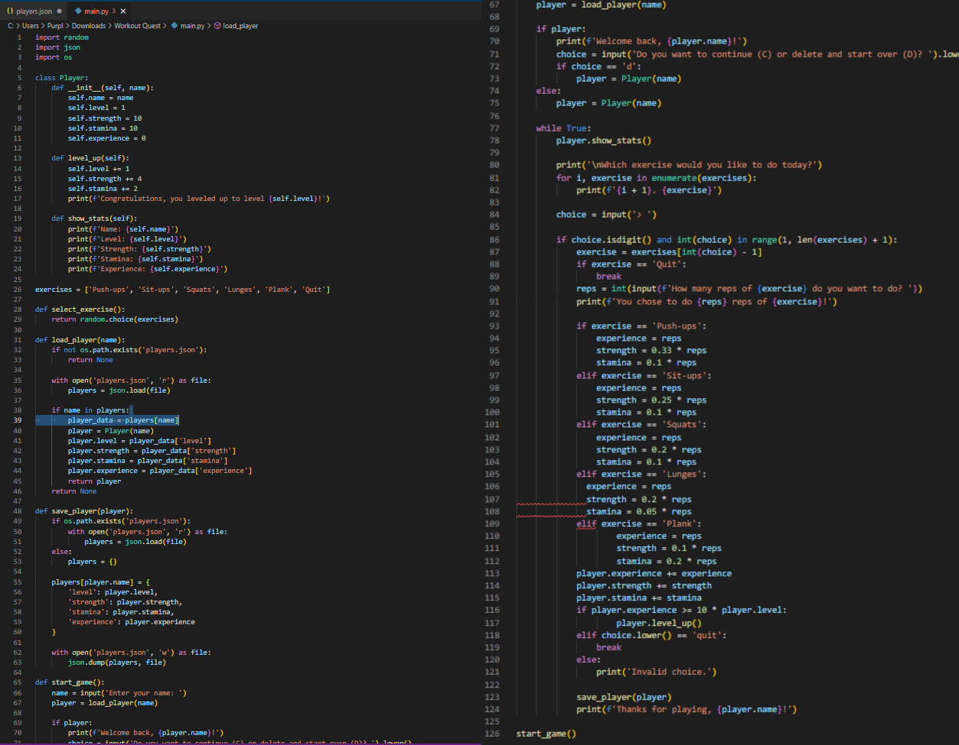
A fitness game and tracker which utilizes RPG elements to provide basic workouts for the gamer just getting into fitness.
Workout Adventure by Nickoli Headlam

